Slide 1

MANAGING KNOWLEDGE
Chapter 11
VIDEO CASES
Case 1: L'Oréal: Knowledge Management Using Microsoft SharePoint
Case 2: IdeaScale Crowdsourcing: Where Ideas Come to Life

Slide 2
CHAPTER 11: MANAGING KNOWLEDGE
Learning Objectives
What is the role of knowledge management and knowledge management programs in business?
What types of systems are used for enterprise-wide knowledge management and how do they provide value for businesses?
What are the major types of knowledge work systems and how do they provide value for firms?
What are the business benefits of using intelligent techniques for knowledge management?
© Prentice Hall 2011
Notes:
The purpose of this chapter is to discuss the business value of knowledge and describe how knowledge is created and managed in the firm. For most students, the idea of business being dependent on knowledge will be a new idea. At this point, show them your cell phone and ask them what kind of knowledge would be needed by an organization to make devices like this? You might ask students to come up with definitions of knowledge and to distinguish knowledge from data, information, and wisdom. Give examples of types of organizations (hospital, law firm, car dealership, diner, school, etc.) and ask students to come up with specific examples of knowledge that would be important to that organization.

Slide 3
CHAPTER 11: MANAGING KNOWLEDGE
P&G Moves from Paper to Pixels for Knowledge Management
Problem: Document-intensive research and development dependent on paper records
Solutions: Electronic document management system stores research information digitally
eLab Notebook documentum management software creates PDFs, enables digital signatures, embeds usage rights, enables digital searching of library
Demonstrates IT’s role in reducing cost by making organizational knowledge more easily available
Illustrates how an organization can become more efficient and profitable through content management
© Prentice Hall 2011
Notes:
This case study discusses the deployment of a content management system at P&G to facilitate knowledge sharing and eliminate paperwork and its effects on work flow. You might ask students to identify why knowledge is important to Proctor & Gamble. Ask students to describe the business value of a content management system to a company like Procter & Gamble. What effects did implementing the knowledge system have on employees? Can they imagine any detrimental effects on employees?

Slide 4
CHAPTER 11: MANAGING KNOWLEDGE
The Knowledge Management Landscape
Knowledge management systems among fastest growing areas of software investment
Information economy
  55% U.S. labor force: knowledge and information workers
  60% U.S. GDP from knowledge and information sectors
Substantial part of a firm’s stock market value is related to intangible assets: knowledge, brands, reputations, and unique business processes
Well-executed knowledge-based projects can produce extraordinary ROI
© Prentice Hall 2011
Notes:
This slide emphasizes the role of knowledge today in the U.S. economy. Ask students to give examples of knowledge and information sectors (finance, publishing, etc.). It may come as a surprise to students that more than half the value of all stocks listed on the New York Stock Exchange is attributed to intangible assets like knowledge and know-how.

Slide 5
CHAPTER 11: MANAGING KNOWLEDGE
The Knowledge Management Landscape
Important dimensions of knowledge
  Knowledge is a firm asset
    Intangible
    Creation of knowledge from data, information, requires organizational resources
    As it is shared, experiences network effects
  Knowledge has different forms
    May be explicit (documented) or tacit (residing in minds)
    Know-how, craft, skill
    How to follow procedure
    Knowing why things happen (causality)
© Prentice Hall 2011
Notes:
This slide and the next begin to answer the question, “What is knowledge” as it pertains to the organization. Ask the students why it is important to define and describe knowledge. Ask students to provide examples of knowledge, given an example industry, that illustrate that it is a “firm asset”. (E.g. For an electrical appliances firm, knowing how to make the most efficient and cheapest air conditioner). Ask students to explain each element of the dimensions, providing examples. For example, what is meant by “knowledge is intangible”? Have students give an example of explicit knowledge etc.

Slide 6
CHAPTER 11: MANAGING KNOWLEDGE
The Knowledge Management Landscape
Important dimensions of knowledge (cont.)
  Knowledge has a location
    Cognitive event
    Both social and individual
    “Sticky” (hard to move), situated (enmeshed in firm’s culture), contextual (works only in certain situations)
  Knowledge is situational
    Conditional: Knowing when to apply procedure
    Contextual: Knowing circumstances to use certain tool
© Prentice Hall 2011
Notes:
This slide continues the discussion from the previous slide, in answering the question, “What is knowledge” as it pertains to the organization. Ask students to further explain or give examples for each characteristic. For example, “What is an example of knowledge with a social basis?” “What is an example of knowledge that is sticky; what is sticky about it?”

Slide 7
CHAPTER 11: MANAGING KNOWLEDGE
The Knowledge Management Landscape
To transform information into knowledge, firm must expend additional resources to discover patterns, rules, and contexts where knowledge works
Wisdom:
  Collective and individual experience of applying knowledge to solve problems
  Involves where, when, and how to apply knowledge
Knowing how to do things effectively and efficiently in ways others cannot duplicate is prime source of profit and competitive advantage
  E.g., Having a unique build-to-order production system
© Prentice Hall 2011
Notes:
This slide emphasizes the value of knowledge to the organization, making distinctions between data, information, knowledge, and wisdom. Ask the students to distinguish between data, information, knowledge, and wisdom. Give examples of well-known companies and ask students to describe knowledge the company has that gives it competitive advantage, such as Apple, eBay, the Gap, Burger King, etc. It might also be a good time to point out what is the value of a “skilled labor force.” That value results from the knowledge employees have to do their jobs efficiently and effectively. This knowledge in the heads of employees is hard to replace.

Slide 8
CHAPTER 11: MANAGING KNOWLEDGE
The Knowledge Management Landscape
Organizational learning
  Process in which organizations learn
    Gain experience through collection of data, measurement, trial and error, and feedback
    Adjust behavior to reflect experience
      Create new business processes
      Change patterns of management decision making
© Prentice Hall 2011
Notes:
This slide introduces the concept of organizational learning, which describes the process of gathering, creating, and applying knowledge. Most students will be surprised that organizations learn, and others will provide many examples of organizations which refused to learn anything.
In organizational learning, knowledge becomes the driver of new behavior – decision making, new products and services, new business processes. This might be seen also as organizations sensing and responding to their environment. Give the students examples of organizations, such as a school, hospital, bank, clothing manufacturer, and ask them to provide examples of how that business might demonstrate organizational learning. How well do students think the Big Three automakers in the U.S. learned in the past twenty years?

Slide 9
CHAPTER 11: MANAGING KNOWLEDGE
The Knowledge Management Landscape
Knowledge management: Set of business processes developed in an organization to create, store, transfer, and apply knowledge
Knowledge management value chain:
  Each stage adds value to raw data and information as they are transformed into usable knowledge
  Knowledge acquisition
  Knowledge storage
  Knowledge dissemination
  Knowledge application
© Prentice Hall 2011
Notes:
This slide defines the term knowledge management and describes the process from acquiring knowledge to applying it as a value chain, and is followed by slides detailing each stage. Each stage of the chain adds more value to the raw data and information. Ask the students to differentiate between the stages, and how each stage could incorporate more value? For example, how does knowledge once it is stored incorporate more value than the previous stage, knowledge that is being acquired?

Slide 10
CHAPTER 11: MANAGING KNOWLEDGE
The Knowledge Management Landscape
Knowledge management value chain
  Knowledge acquisition
    Documenting tacit and explicit knowledge
      Storing documents, reports, presentations, best practices
      Unstructured documents (e.g., e-mails)
      Developing online expert networks
    Creating knowledge
    Tracking data from TPS and external sources
© Prentice Hall 2011
Notes:
This slide describes the first stage of the knowledge value chain, knowledge acquisition and details different ways knowledge can be gathered. Use the example of a specific type of business or organization, such as a paper manufacturer or university, and have the students describe how that business might acquire or create knowledge. For example, what types of knowledge would a paper manufacturer be interested and how would they gather or create that?

Slide 11
CHAPTER 11: MANAGING KNOWLEDGE
The Knowledge Management Landscape
Knowledge management value chain (cont.)
  Knowledge storage
    Databases
    Document management systems
    Role of management:
      Support development of planned knowledge storage systems
      Encourage development of corporate-wide schemas for indexing documents
      Reward employees for taking time to update and store documents properly
© Prentice Hall 2011
Notes:
This slide discusses the second stage of the knowledge value chain, knowledge storage, describing the ways in which knowledge is stored as well as the importance of management in creating and maintaining repositories of knowledge. Give the students an example company, such as a medical practice, and ask what type of knowledge they would need and how it should be stored (e.g. medical records of patients).

Slide 12
CHAPTER 11: MANAGING KNOWLEDGE
The Knowledge Management Landscape
Knowledge management value chain (cont.)
  Knowledge dissemination
    Portals
    Push e-mail reports
    Search engines
    Collaboration tools
    A deluge of information?
      Training programs, informal networks, and shared management experience help managers focus attention on important information
© Prentice Hall 2011
Notes:
This slide discusses the third stage of the knowledge value chain and describes various ways that knowledge can be disseminated within the organization. Ask the students for examples of how they received knowledge from a job they have had or a university or college they have attended. What type of knowledge was transferred and what means were used? Were these methods of dissemination adequate or do they see more effective ways to disseminate the same information? How can a company or its employees have “too much information”?

Slide 13
CHAPTER 11: MANAGING KNOWLEDGE
The Knowledge Management Landscape
Knowledge management value chain (cont.)
  Knowledge application
    To provide return on investment, organizational knowledge must become systematic part of management decision making and become situated in decision-support systems
      New business practices
      New products and services
      New markets
© Prentice Hall 2011
Notes:
This slide discusses the last stage of the knowledge value chain, knowledge application, and emphasizes the need to see and evaluate knowledge in terms of organizational capital and return on investment. Ask the students if they have any examples from their own experience in education or work of how new knowledge can result in a new business practice, new product, or new market.

Slide 14
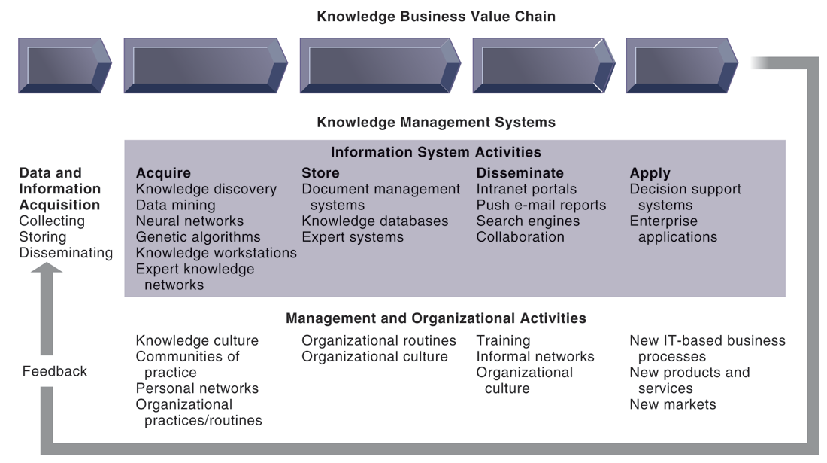
CHAPTER 11: MANAGING KNOWLEDGE
The Knowledge Management Landscape
THE KNOWLEDGE MANAGEMENT VALUE CHAIN
FIGURE 11-1
Knowledge management today involves both information systems activities and a host of enabling management and organizational activities.
© Prentice Hall 2011
Notes:
This graphic details the stages of the knowledge management value chain, separating the information system activities from the management/organizational activities involved at each stage. It also describes two very other important requirements for the value chain, the initial data and information acquisition that forms the basis for creating knowledge, and feedback from the knowledge application stage that can result in new opportunities for data and knowledge creation.

Slide 15
CHAPTER 11: MANAGING KNOWLEDGE
The Knowledge Management Landscape
New organizational roles and responsibilities
  Chief knowledge officer executives
  Dedicated staff / knowledge managers
  Communities of practice (COPs)
    Informal social networks of professionals and employees within and outside firm who have similar work-related activities and interests
    Activities include education, online newsletters, sharing experiences and techniques
    Facilitate reuse of knowledge, discussion
    Reduce learning curves of new employees
© Prentice Hall 2011
Notes:
This slide discusses the new types of organizational roles that managers can develop in order to facilitate the knowledge value chain. Why might a chief knowledge officer, a senior executive position, be valuable to a company? Ask students why a CKO and COP may or may not be important to the various stages of the value chain – data acquisition, knowledge creation, storage, dissemination, and application, as well as feedback.

Slide 16
CHAPTER 11: MANAGING KNOWLEDGE
The Knowledge Management Landscape
3 major types of knowledge management systems:
  Enterprise-wide knowledge management systems
    General-purpose firm-wide efforts to collect, store, distribute, and apply digital content and knowledge
  Knowledge work systems (KWS)
    Specialized systems built for engineers, scientists, other knowledge workers charged with discovering and creating new knowledge
  Intelligent techniques
    Diverse group of techniques such as data mining used for various goals: discovering knowledge, distilling knowledge, discovering optimal solutions
© Prentice Hall 2011
Notes:
This slide introduces the three main categories of information system used to manage knowledge. These categories are different in terms of the constituencies they server, the purpose for which they are used and what they emphasize.

Slide 17
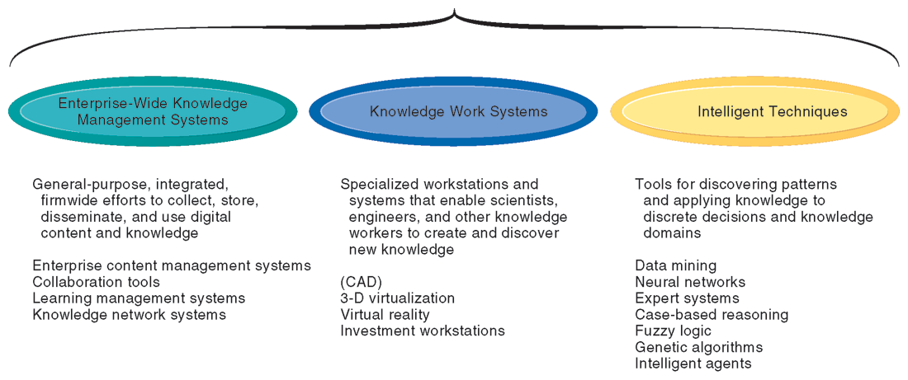
CHAPTER 11: MANAGING KNOWLEDGE
The Knowledge Management Landscape
MAJOR TYPES OF KNOWLEDGE MANAGEMENT SYSTEMS
FIGURE 11-2
There are three major categories of knowledge management systems, and each can be broken down further into more specialized types of knowledge management systems.
© Prentice Hall 2011
Notes:
This graphic illustrates the three major types of knowledge management systems, giving the purpose of the system and examples of the type of system. Ask the students how they would categorize a system that catalogs and stores past advertising campaigns? What about software that helps a research biologist input and analyze lab findings?

Slide 18
CHAPTER 11: MANAGING KNOWLEDGE
Enterprise-Wide Knowledge Management Systems
Three major types of knowledge in enterprise
  Structured documents
    Reports, presentations
    Formal rules
  Semistructured documents
    E-mails, videos
  Unstructured, tacit knowledge
80% of an organization’s business content is semistructured or unstructured
© Prentice Hall 2011
Notes:
This slide describes the three major kinds of knowledge that can be found in an enterprise, and indicates that less formal knowledge may be just as critical as formal knowledge for organizations to store and share. Ask the students for other examples of semistructured and unstructured knowledge. Ask students for an example of tacit knowledge that is more important than structured knowledge such as a report.

Slide 19
CHAPTER 11: MANAGING KNOWLEDGE
Enterprise-Wide Knowledge Management Systems
Enterprise content management systems
  Help capture, store, retrieve, distribute, preserve
    Documents, reports, best practices
    Semistructured knowledge (e-mails)
  Bring in external sources
    News feeds, research
  Tools for communication and collaboration
© Prentice Hall 2011
Notes:
This slide discusses the purpose and features of enterprise-wide content management systems. The text discusses the example of Barrick Gold, which uses OpenText LiveLink Enterprise Content Management to the massive amounts of information needed for building mines, from CAD drawings to contracts, reducing time spent searching for documents, minimizing rework, and improving decisions.

Slide 20
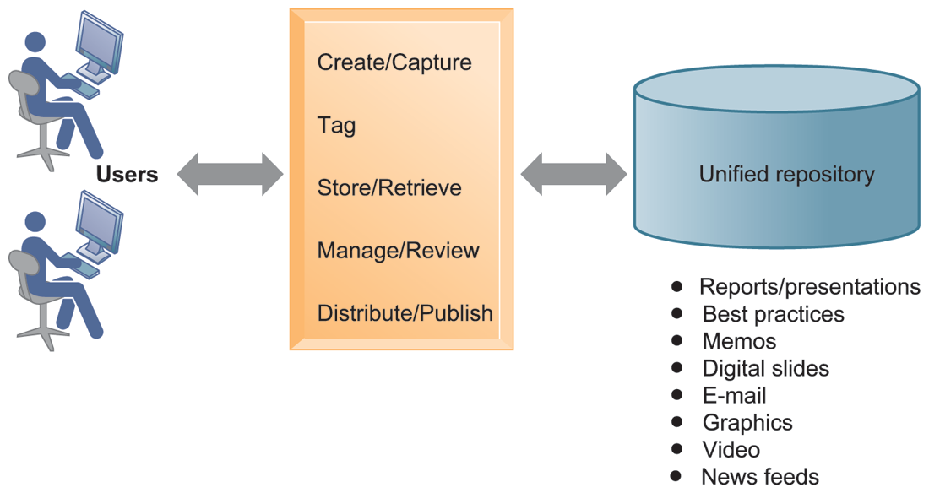
CHAPTER 11: MANAGING KNOWLEDGE
Enterprise-Wide Knowledge Management Systems
AN ENTERPRISE CONTENT MANAGEMENT SYSTEM
FIGURE 11-3
An enterprise content management system has capabilities for classifying, organizing, and managing structured and semistructured knowledge and making it available throughout the enterprise.
© Prentice Hall 2011
Notes:
This graphic illustrates the functions of an enterprise content management system. Users interact with the system to both input knowledge, manage it, and distribute it. These management systems can house a wide variety of information types, from formal reports to graphics, as well as bring in external content resources such as news feeds. Ask students what types of documents would need to be stored by a hospital, bank, law firm, etc.

Slide 21
CHAPTER 11: MANAGING KNOWLEDGE
Enterprise-Wide Knowledge Management Systems
Enterprise content management systems
  Key problem – Developing taxonomy
    Knowledge objects must be tagged with categories for retrieval
  Digital asset management systems
    Specialized content management systems for classifying, storing, managing unstructured digital data
    Photographs, graphics, video, audio
© Prentice Hall 2011
Notes:
This slide continues the discussion of enterprise-wide content management systems. One need when collecting and storing knowledge and documents is describing a knowledge object so that it can be found later by users. Companies must decide and implement classification schemes, or taxonomies, to define categories meaningful to users, and then knowledge objects must be assigned a classification (“tagged”) so that it can be retrieved. Ask students why different companies might need different taxonomies? Why is it a critical task and a difficult task in preparing for a successful content management system? Some content management systems specialize in managing digital media storage and classification. What types of firms may need these digital asset management systems? (Publishers, advertisers, broadcasters, entertainment producers, etc.)

Slide 22
CHAPTER 11: MANAGING KNOWLEDGE
Enterprise-Wide Knowledge Management Systems
Knowledge network systems
  Provide online directory of corporate experts in well-defined knowledge domains
  Use communication technologies to make it easy for employees to find appropriate expert in a company
  May systematize solutions developed by experts and store them in knowledge database
    Best-practices
    Frequently asked questions (FAQ) repository
© Prentice Hall 2011
Notes:
Enterprise content management systems can include or consist of capabilities for the creation and management of unstructured knowledge – knowledge network systems. Ask the students to give examples of unstructured knowledge, given a type of industry or company: a law firm, an advertising firm, a school. What might be the difficulties in establishing a knowledge network system in a company? Contrast this network (crowd centered) approach to a top down structured knowledge management system.

Slide 23
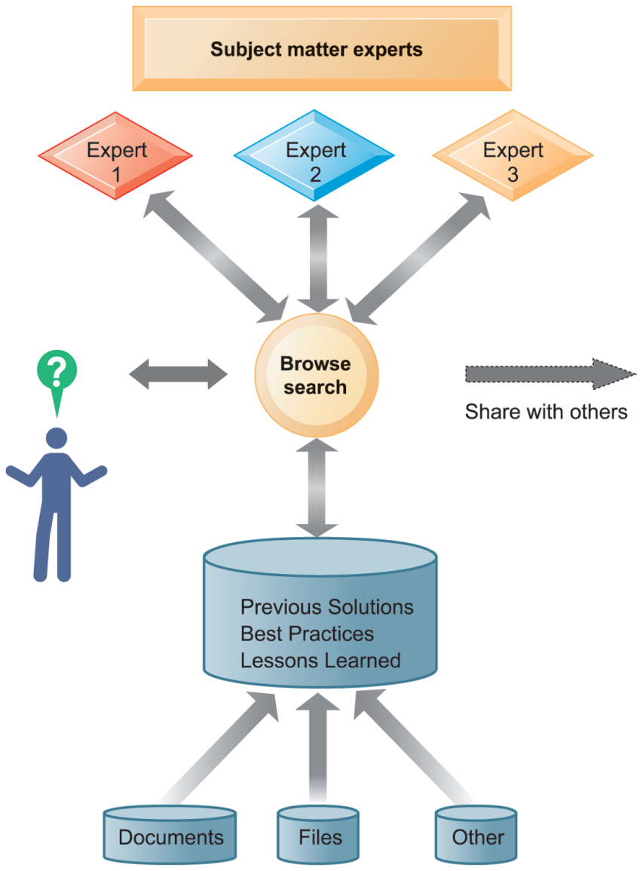
CHAPTER 11: MANAGING KNOWLEDGE
Enterprise-Wide Knowledge Management Systems
AN ENTERPRISE KNOWLEDGE NETWORK SYSTEM
A knowledge network maintains a database of firm experts, as well as accepted solutions to known problems, and then facilitates the communication between employees looking for knowledge and experts who have that knowledge. Solutions created in this communication are then added to a database of solutions in the form of FAQs, best practices, or other documents.
FIGURE 11-4
© Prentice Hall 2011
Notes:
This graphic illustrates the various elements that form a knowledge network system. The user can search for accepted solutions in FAQ or best practices document or contact an expert in the relevant subject matter. Ask the students to provide examples of undocumented, unstructured knowledge they acquired, either in a classroom setting or at work, that would be valuable to peers. What kind of tools would enable sharing this information?

Slide 24
CHAPTER 11: MANAGING KNOWLEDGE
Enterprise-Wide Knowledge Management Systems
Portal and collaboration technologies
  Enterprise knowledge portals: Access to external and internal information
    News feeds, research
    Capabilities for e-mail, chat, videoconferencing, discussion
  Use of consumer Web technologies
    Blogs
    Wikis
    Social bookmarking
© Prentice Hall 2011
Notes:
Enterprise-wide content systems include capabilities for collaboration and learning management. Ask students how a blog and wiki would help a company in terms of collaboration. Have any of the students used or created a wiki? Ask students if they have used social bookmarking personally and to describe how it works. Ask them how social bookmarking would be valuable as a collaboration tool for a business. Are there any potential problems in using social bookmarking (tagging). The term for user created taxonomies is folksonomies.

Slide 25
CHAPTER 11: MANAGING KNOWLEDGE
Enterprise-Wide Knowledge Management Systems
Learning management systems
  Provide tools for management, delivery, tracking, and assessment of various types of employee learning and training
  Support multiple modes of learning
    CD-ROM, Web-based classes, online forums, live instruction, etc.
  Automates selection and administration of courses
  Assembles and delivers learning content
  Measures learning effectiveness
© Prentice Hall 2011
Notes:
This slide discusses learning management systems, which enable companies to track and manage employee learning. Ask students what are the benefits and drawbacks of using an LMS with centralized reporting.

Slide 26
CHAPTER 11: MANAGING KNOWLEDGE
Knowledge Work Systems
Knowledge work systems
  Systems for knowledge workers to help create new knowledge and integrate that knowledge into business
Knowledge workers
  Researchers, designers, architects, scientists, engineers who create knowledge for the organization
  Three key roles:
    Keeping organization current in knowledge
    Serving as internal consultants regarding their areas of expertise
    Acting as change agents, evaluating, initiating, and promoting change projects
© Prentice Hall 2011
Notes:
This slide discusses the second main type of knowledge management system: the knowledge work system, and identifies the importance of knowledge workers to an organization and its knowledge creation. Ask the students why each of the three roles listed is important to an organization. Can all companies benefit from knowledge workers, or only design, science, and engineering firms?

Slide 27
CHAPTER 11: MANAGING KNOWLEDGE
Knowledge Work Systems
Requirements of knowledge work systems
  Substantial computing power for graphics, complex calculations
  Powerful graphics and analytical tools
  Communications and document management
  Access to external databases
  User-friendly interfaces
  Optimized for tasks to be performed (design engineering, financial analysis)
© Prentice Hall 2011
Notes:
This slide continues the discussion of knowledge work systems, emphasizing the need of knowledge workers to have highly specialized knowledge work systems. Ask students to describe the reasons that these characteristics are important for a knowledge work system. What other types of information systems would a knowledge worker rely on, if any? (office systems, productivity systems, scheduling systems).

Slide 28
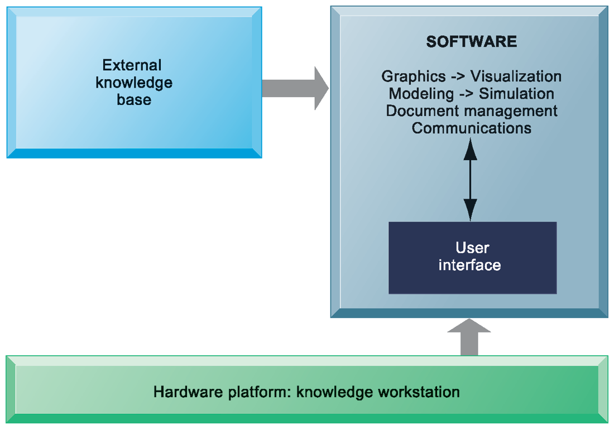
CHAPTER 11: MANAGING KNOWLEDGE
Knowledge Work Systems
REQUIREMENTS OF KNOWLEDGE WORK SYSTEMS
Knowledge work systems require strong links to external knowledge bases in addition to specialized hardware and software.
FIGURE 11-5
© Prentice Hall 2011
Notes:
This graphic illustrates the main components of a knowledge work station: having the need for both specialized software and hardware, access to external information, and an easy-to-use interface. What types of external knowledge might be valuable to an engineer, a financial analyst, a medical researcher?

Slide 29
CHAPTER 11: MANAGING KNOWLEDGE
Knowledge Work Systems
Examples of knowledge work systems
  CAD (computer-aided design):
    Creation of engineering or architectural designs
  Virtual reality systems:
    Simulate real-life environments
    3-D medical modeling for surgeons
    Augmented reality (AR) systems
    VRML
  Investment workstations:
    Streamline investment process and consolidate internal, external data for brokers, traders, portfolio managers
© Prentice Hall 2011
Notes:
This slide describes three types of knowledge work systems: CAD systems, virtual reality systems, and investment work stations. Ask students what the business value of providing a financial analyst, engineer, or researcher with an improved, specialized work station would be. Can the value of implementing or upgrading work systems be quantified into a monetary value? The text discusses virtual reality systems as an aid in medicine and engineering, and uses the example of the virtual reality system that helps mechanics in Boeing Co.’s 25-day training course for its 787 Dreamliner learn to fix all kinds of problems, from broken lights in the cabin to major glitches with flight controls. Note that augmented reality (AR) is a related technology for enhancing visualization. AR provides a live direct or indirect view of a physical real-world environment whose elements are augmented by virtual computer-generated imagery. The user is grounded in the real physical world, and the virtual images are merged with the real view to create the augmented display. What other industries might benefit from the use of virtual reality systems by their knowledge workers?

Slide 30
CHAPTER 11: MANAGING KNOWLEDGE
Knowledge Work Systems
AUGMENTED REALITY: REALITY GETS BETTER
What is the difference between virtual reality and augmented reality?
Why is augmented reality so appealing to marketers?
What makes augmented reality useful for real estate shopping applications?
Suggest some other knowledge work applications for augmented reality
© Prentice Hall 2011
Notes:
This slide presents discussion questions regarding the case study on augmented reality systems. AR systems mix real-life images with graphics or other effects and can use any of three major display techniques—head-mounted displays, spatial displays, which display graphical information on physical objects, and handheld displays. A familiar example is the yellow first-down markers shown on televised football games. Other common usages of AR include medical procedures like image-guided surgery and uses in military training, engineering design, robotics, and consumer design.

Slide 31
CHAPTER 11: MANAGING KNOWLEDGE
Intelligent Techniques
Intelligent techniques: Used to capture individual and collective knowledge and to extend knowledge base
  To capture tacit knowledge: Expert systems, case-based reasoning, fuzzy logic
  Knowledge discovery: Neural networks and data mining
  Generating solutions to complex problems: Genetic algorithms
  Automating tasks: Intelligent agents
Artificial intelligence (AI) technology:
  Computer-based systems that emulate human behavior
© Prentice Hall 2011
Notes:
This slide introduces the third of the three main types of knowledge management systems: intelligent techniques, and categorizes them according to the type of knowledge involved. AI technology is used in some techniques as part of the logical computerized routine. The text discusses AI systems being able to learn languages, and emulate human expertise and decision making. What might be some of the benefits and drawbacks to AI technology? Are there any ethical considerations?

Slide 32
CHAPTER 11: MANAGING KNOWLEDGE
Intelligent Techniques
Expert systems:
  Capture tacit knowledge in very specific and limited domain of human expertise
  Capture knowledge of skilled employees as set of rules in software system that can be used by others in organization
  Typically perform limited tasks that may take a few minutes or hours, e.g.:
    Diagnosing malfunctioning machine
    Determining whether to grant credit for loan
  Used for discrete, highly structured decision-making
© Prentice Hall 2011
Notes:
This slide describes expert systems, one type of intelligent technique. Ask students why expert systems are best used in highly structured decision-making situations. Ask students to provide an example of a decision that could not be solved by an expert system. Choice of music, potential spouses or mates, new product decisions, or designing a new marketing campaign might be good examples of poorly structured decision situations.

Slide 33
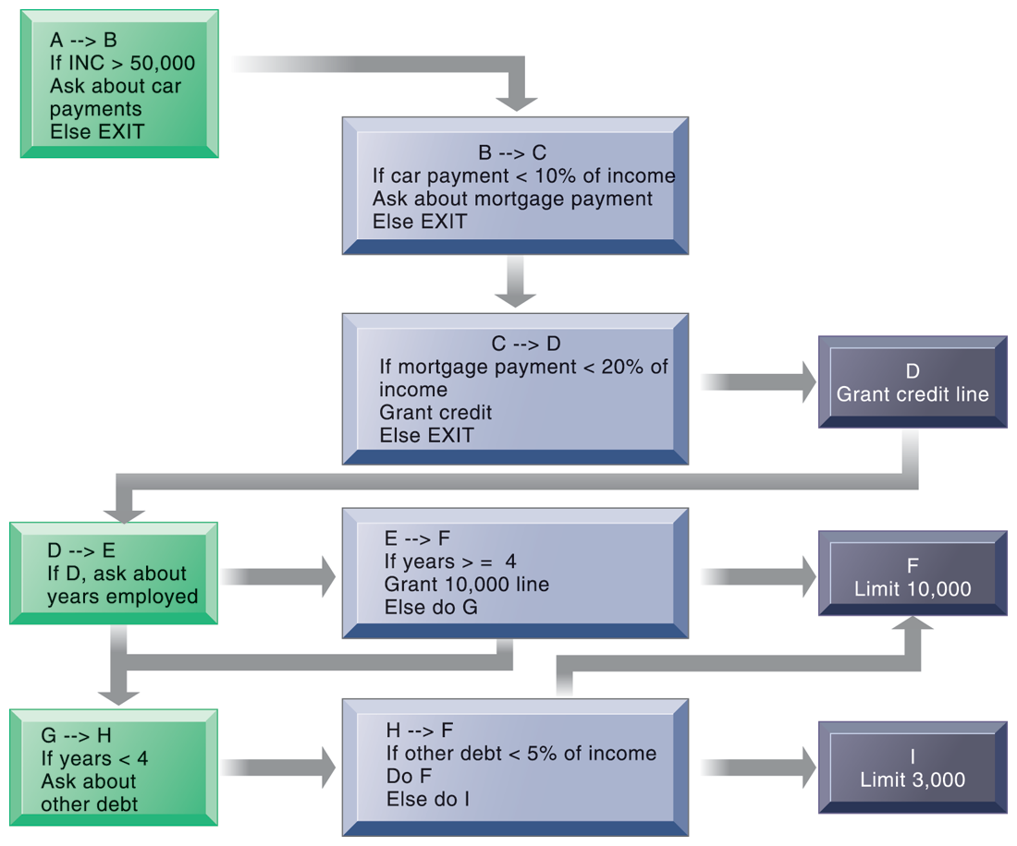
CHAPTER 11: MANAGING KNOWLEDGE
Intelligent Techniques
RULES IN AN EXPERT SYSTEM
An expert system contains a number of rules to be followed. The rules are interconnected; the number of outcomes is known in advance and is limited; there are multiple paths to the same outcome; and the system can consider multiple rules at a single time. The rules illustrated are for simple credit-granting expert systems.
FIGURE 11-6
© Prentice Hall 2011
Notes:
This graphic illustrates the use of if/then rules in an expert system. Ask students to demonstrate an understanding of if/then rules, by analyzing a common decision as a series of if/then statements; for example, the decision to accept an invitation to socialize on a weeknight, or the decision of what to make for dinner.

Slide 34
CHAPTER 11: MANAGING KNOWLEDGE
Intelligent Techniques
How expert systems work
  Knowledge base: Set of hundreds or thousands of rules
  Inference engine: Strategy used to search knowledge base
    Forward chaining: Inference engine begins with information entered by user and searches knowledge base to arrive at conclusion
    Backward chaining: Begins with hypothesis and asks user questions until hypothesis is confirmed or disproved
© Prentice Hall 2011
Notes:
This slide continues the discussion of expert systems and describes how they work. Their key elements are their knowledge base and their inference engine. Ask students to demonstrate an understanding of the difference between forward chaining and backward chaining. For example, given a hypothesized expert system to determine what to make for dinner, what would an inference engine with forward chaining begin with? (Example, is there chicken? Is there beef? Is there broccoli, etc.? What are all the ingredients available and what could be made from them?) What would an inference with backward chaining begin with? (We are making chicken with broccoli. Do we have the ingredients?)

Slide 35
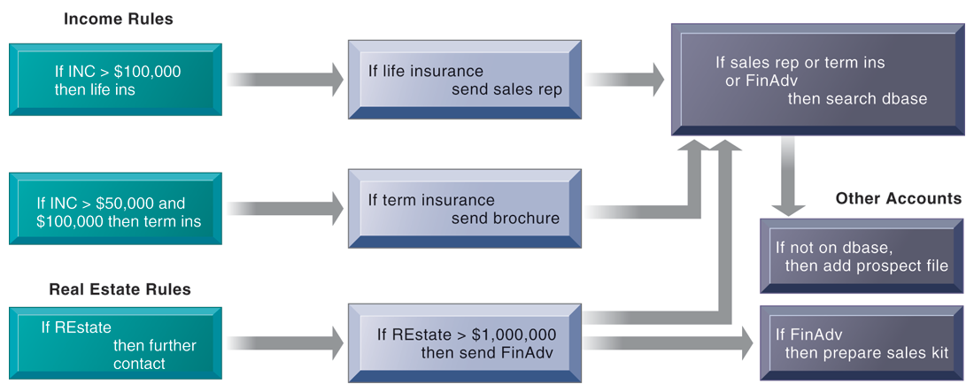
CHAPTER 11: MANAGING KNOWLEDGE
Intelligent Techniques
INFERENCE ENGINES IN EXPERT SYSTEMS
FIGURE 11-7
An inference engine works by searching through the rules and “firing” those rules that are triggered by facts gathered and entered by the user. Basically, a collection of rules is similar to a series of nested IF statements in a traditional software program; however, the magnitude of the statements and degree of nesting are much greater in an expert system.
© Prentice Hall 2011
Notes:
This graphic illustrates the types of rules that might be used by salespeople to determine whether or not to add a client to a prospect database. Ask students to demonstrate, using this chart, what would happen to a client that was determined to have an income of $80,000 and was given Financial Advice.

Slide 36
CHAPTER 11: MANAGING KNOWLEDGE
Intelligent Techniques
Successful expert systems
  Con-Way Transportation built expert system to automate and optimize planning of overnight shipment routes for nationwide freight-trucking business
Most expert systems deal with problems of classification
  Have relatively few alternative outcomes
  Possible outcomes are known in advance
Many expert systems require large, lengthy, and expensive development and maintenance efforts
  Hiring or training more experts may be less expensive
© Prentice Hall 2011
Notes:
This slide continues the discussion of expert systems, citing an example of a successful system, and discussing the types of problems that benefit from expert systems as well as the potential drawbacks to implementing expert systems. Could an expert system be used to diagnose a medical condition? What might be the drawbacks to using an expert system for medical diagnosis?

Slide 37
CHAPTER 11: MANAGING KNOWLEDGE
Intelligent Techniques
Case-based reasoning (CBR)
  Descriptions of past experiences of human specialists (cases), stored in knowledge base
  System searches for cases with problem characteristics similar to new one, finds closest fit, and applies solutions of old case to new case
  Successful and unsuccessful applications are grouped with case
  Stores organizational intelligence: Knowledge base is continuously expanded and refined by users
  CBR found in
    Medical diagnostic systems
    Customer support
© Prentice Hall 2011
Notes:
This slide discusses a second type of intelligent technique: case-based reasoning. What would be the difference in how a CBR system would be used in medical diagnosis versus an expert system? Ask students which of the two techniques would be better at medical diagnosis and why?

Slide 38
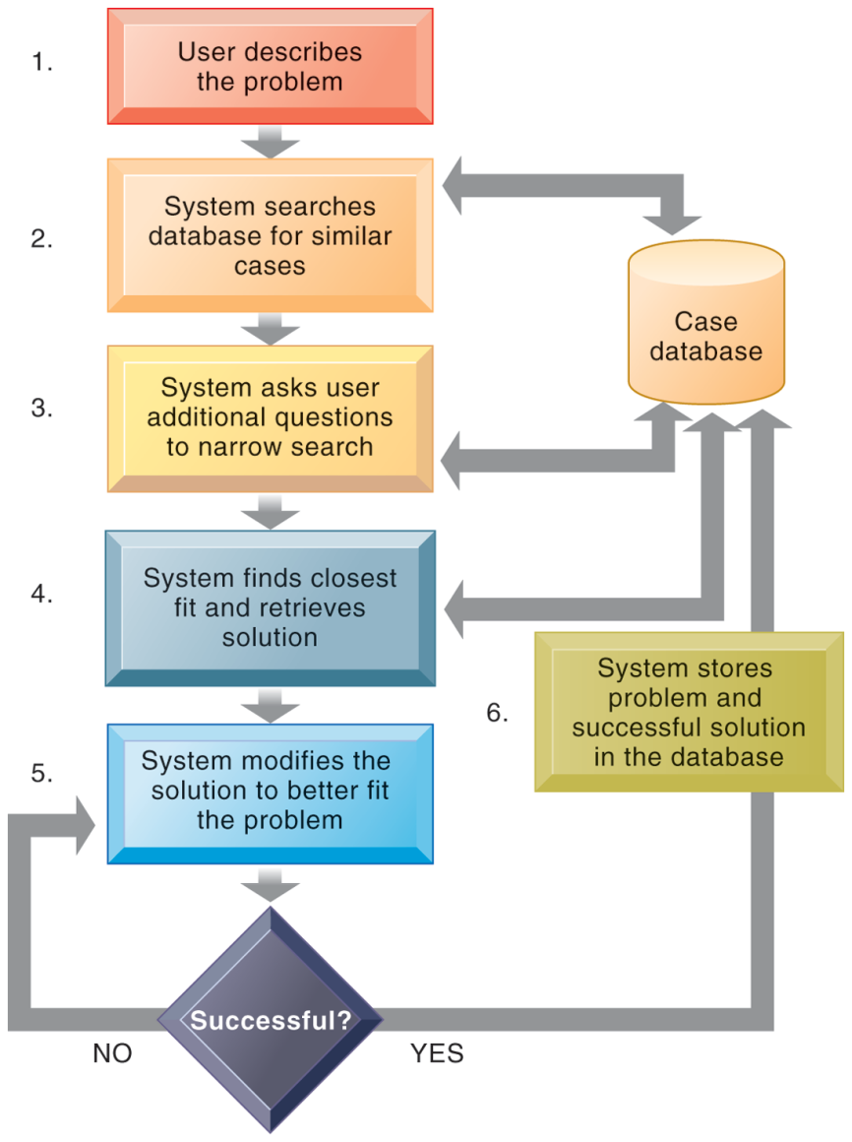
CHAPTER 11: MANAGING KNOWLEDGE
Intelligent Techniques
HOW CASE-BASED REASONING WORKS
Case-based reasoning represents knowledge as a database of past cases and their solutions. The system uses a six-step process to generate solutions to new problems encountered by the user.
FIGURE 11-8
© Prentice Hall 2011
Notes:
This graphic demonstrates the six main steps in case based reasoning. Ask the students to compare expert systems with CBR. What are the benefits and drawbacks in CBR as a technique? What types of problems lend themselves to CBR?

Slide 39
CHAPTER 11: MANAGING KNOWLEDGE
Intelligent Techniques
Fuzzy logic systems
  Rule-based technology that represents imprecision used in linguistic categories (e.g., “cold,” “cool”) that represent range of values
  Describe a particular phenomenon or process linguistically and then represent that description in a small number of flexible rules
  Provides solutions to problems requiring expertise that is difficult to represent with IF-THEN rules
    Autofocus in cameras
    Detecting possible medical fraud
    Sendai’s subway system acceleration controls
© Prentice Hall 2011
Notes:
This slide discusses a third type of intelligent technique: fuzzy logic. The text discusses the use of fuzzy logic to control room temperature automatically using imprecise values for temperature, humidity, outdoor wind, and outdoor temperature, in order to evaluate current room conditions and respond appropriately. Ask students what might be the imprecise values used in the fuzzy logic for camera autofocus, medical fraud detection, and subway acceleration. Could fuzzy logic be used in medical diagnosis? How would this work?

Slide 40
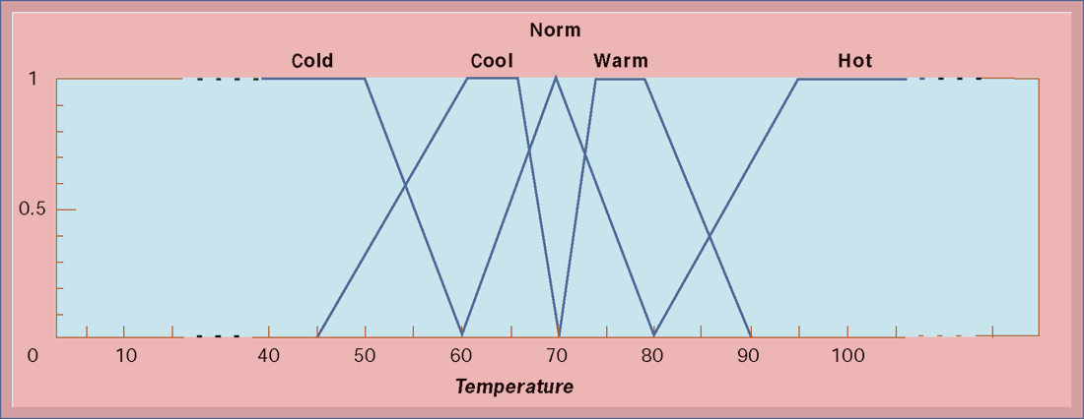
CHAPTER 11: MANAGING KNOWLEDGE
Intelligent Techniques
FUZZY LOGIC FOR TEMPERATURE CONTROL
FIGURE 11-9
The membership functions for the input called temperature are in the logic of the thermostat to control the room temperature. Membership functions help translate linguistic expressions such as warm into numbers that the computer can manipulate.
© Prentice Hall 2011
Notes:
This graphic illustrates how a fuzzy logic system for room air conditioning might represent the imprecise values for temperature. Ask students what the benefit is of using imprecise values?

Slide 41
CHAPTER 11: MANAGING KNOWLEDGE
Intelligent Techniques
Neural networks
  Find patterns and relationships in massive amounts of data too complicated for humans to analyze
  “Learn” patterns by searching for relationships, building models, and correcting over and over again
  Humans “train” network by feeding it data inputs for which outputs are known, to help neural network learn solution by example
  Used in medicine, science, and business for problems in pattern classification, prediction, financial analysis, and control and optimization
  Machine learning: Related AI technology allowing computers to learn by extracting information using computation and statistical methods
© Prentice Hall 2011
Notes:
This slide discusses a fourth intelligent technique: neural networks. Ask students whether neural networks could be used in medical diagnosis? How would this work? To some extent, data mining techniques have replaced neural networks in situations requiring pattern recognition. For instance credit card companies sift through mountains of transaction data to identify which charging patterns are unlikely for each and every charge card customer.

Slide 42
CHAPTER 11: MANAGING KNOWLEDGE
Intelligent Techniques
THE FLASH CRASH: MACHINES GONE WILD?
Describe the conditions that preceded the flash crash.
What are some of the benefits of electronic trading?
What features of electronic trading and automated trading programs contributed to the crash?
Could this crash have been prevented? Why or why not?
© Prentice Hall 2011
Notes:
This slide presents discussion questions regarding the chapter case on the stock market crash on May 6, 2010, in which the Dow Jones dropped almost 1000 points, but recovering much of this by the end of the day. The abrupt selling activities of a single mutual fund company touched off a chain reaction among automated financial trading systems. While computerized systems simply continued to push the market lower, humans were unable to react fast enough to the situation.

Slide 43
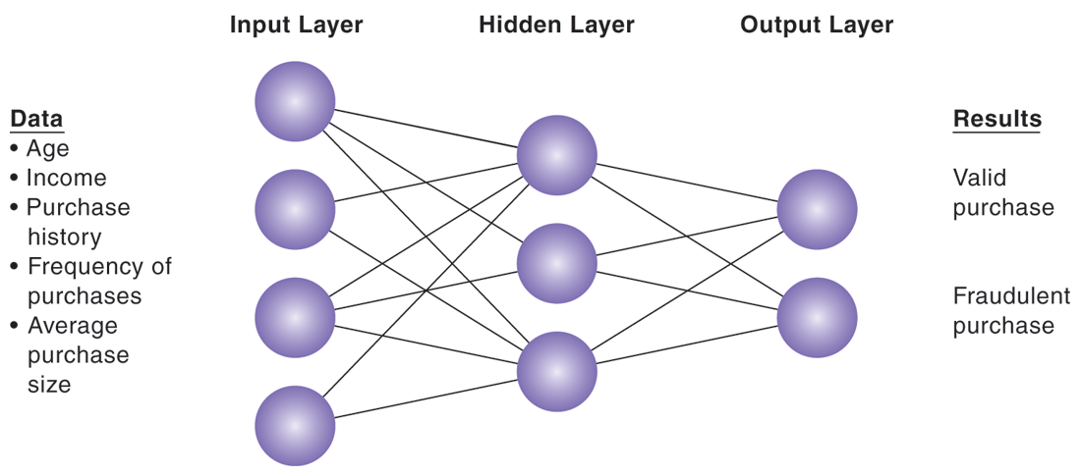
CHAPTER 11: MANAGING KNOWLEDGE
Intelligent Techniques
HOW A NEURAL NETWORK WORKS
FIGURE 11-10
A neural network uses rules it “learns” from patterns in data to construct a hidden layer of logic. The hidden layer then processes inputs, classifying them based on the experience of the model. In this example, the neural network has been trained to distinguish between valid and fraudulent credit card purchases
© Prentice Hall 2011
Notes:
This graphic illustrates how a neural network works – by using an internal, hidden layer of logic that examines existing data and assigning a classification to that set of data. For example, given one or more specific combinations of age, income, purchase history, frequency of purchases, and average purchase size, a neural network might determine that a new credit card purchase was likely to be fraudulent. What are the benefits and drawbacks of using this type of technique?

Slide 44
CHAPTER 11: MANAGING KNOWLEDGE
Intelligent Techniques
Genetic algorithms
  Useful for finding optimal solution for specific problem by examining very large number of possible solutions for that problem
  Conceptually based on process of evolution
    Search among solution variables by changing and reorganizing component parts using processes such as inheritance, mutation, and selection
  Used in optimization problems (minimization of costs, efficient scheduling, optimal jet engine design) in which hundreds or thousands of variables exist
  Able to evaluate many solution alternatives quickly
© Prentice Hall 2011
Notes:
This slide discusses a fifth type of intelligent technique: genetic algorithms. Ask students whether genetic algorithms might be useful in medical diagnosis. Why or why not? Ask students to differentiate between the various intelligent techniques discussed this far – expert systems, CBR, fuzzy logic, neural networks, and genetic algorithms.

Slide 45
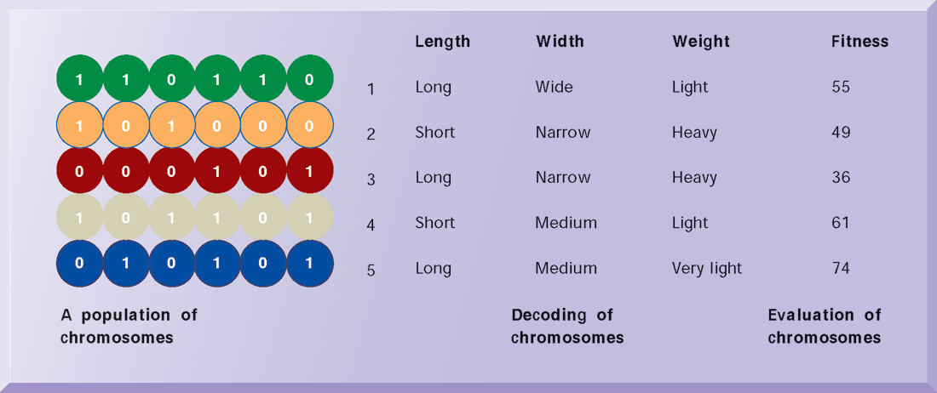
CHAPTER 11: MANAGING KNOWLEDGE
Intelligent Techniques
THE COMPONENTS OF A GENETIC ALGORITHM
FIGURE 11-11
This example illustrates an initial population of “chromosomes,” each representing a different solution. The genetic algorithm uses an iterative process to refine the initial solutions so that the better ones, those with the higher fitness, are more likely to emerge as the best solution.
© Prentice Hall 2011
Notes:
This graphic illustrates the components of a genetic algorithm – “chromosomes”, each with a variety of characteristics that can be compared for overall fitness in a given situation. Ask students what types of problems genetic algorithms are suited for.

Slide 46
CHAPTER 11: MANAGING KNOWLEDGE
Intelligent Techniques
Hybrid AI systems
  Genetic algorithms, fuzzy logic, neural networks, and expert systems integrated into single application to take advantage of best features of each
  E.g., Matsushita “neurofuzzy” washing machine that combines fuzzy logic with neural networks
© Prentice Hall 2011
Notes:
This slide discusses hybrid AI systems, which combine two or more of the techniques previously discussed. Would a hybrid AI system be better suited for medical diagnosis than a purely CBR or expert system?

Slide 47
CHAPTER 11: MANAGING KNOWLEDGE
Intelligent Techniques
Intelligent agents
  Work in background to carry out specific, repetitive, and predictable tasks for user, process, or application
  Use limited built-in or learned knowledge base to accomplish tasks or make decisions on user’s behalf
    Deleting junk e-mail
    Finding cheapest airfare
  Agent-based modeling applications:
    Systems of autonomous agents
    Model behavior of consumers, stock markets, and supply chains; used to predict spread of epidemics
© Prentice Hall 2011
Notes:
This slide discusses the use of intelligent agents to carry out repetitive tasks for a user or system. Shopping bots discussed in an earlier chapter are an example of an intelligent agent. As an example of agent-based modeling, Procter & Gamble used agent-based modeling to improve coordination among supply-chain members.

Slide 48
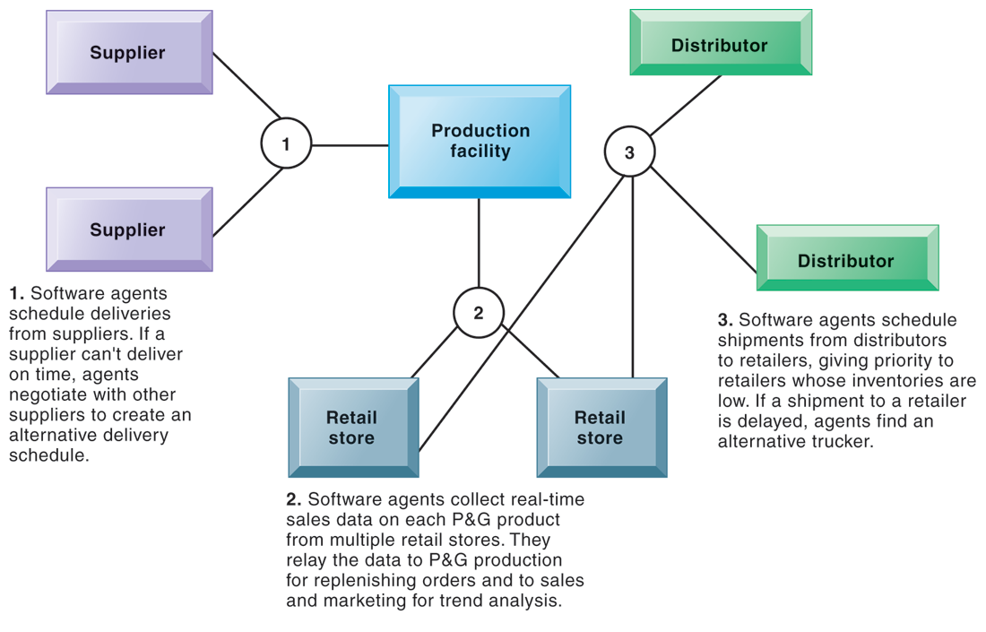
CHAPTER 11: MANAGING KNOWLEDGE
Intelligent Techniques
INTELLIGENT AGENTS IN P&G’S SUPPLY CHAIN NETWORK
FIGURE 11-12
Intelligent agents are helping P&G shorten the replenishment cycles for products, such as a box of Tide.
© Prentice Hall 2011
Notes:
This graphic illustrates Procter & Gamble’s use of intelligent agents in its supply chain network. Given that intelligent-agent modeling mimics the behavior of a number of “actors” in a given situation, what other types of situations might benefit from this type of analysis?

Slide 49
CHAPTER 11: MANAGING KNOWLEDGE
© Prentice Hall 2011

